Slide 1
The Long Short-Term Memory
UNIT - 4

Slide 2
What is LSTM?
Long Short-Term Memory (LSTM) is a type of Recurrent Neural Network (RNN) architecture specifically designed to address the limitations of traditional RNNs, especially the vanishing and exploding gradient problems.
These problems often prevent traditional RNNs from effectively learning long-term dependencies in sequential data, which is critical for tasks like natural language processing, time-series forecasting, and speech recognition.
LSTMs introduce special mechanisms, called gates, to regulate the flow of information, enabling them to capture dependencies over longer time horizons.

Slide 3
LSTM Components
Cell State (𝐶_{t}​ ):
  This is the "memory" of the LSTM, which carries information across different time steps.
  The cell state can flow through the entire sequence with minimal modification, providing a way for the LSTM to remember information over long periods.
Gates:
  Gates are a set of neural network layers that control the flow of information into and out of the cell state.
  They help decide what information should be remembered, updated, or forgotten.

Slide 4
  The three main gates are:
    Forget Gate (𝑓_{𝑡}): Decides what information to discard from the cell state.
    Input Gate (i_{t}​ ): Determines what new information will be stored in the cell state.
    Output Gate (O_{t}): Controls what part of the cell state to output at the current time step.
These gates use activation functions (typically sigmoid and tanh) to control the flow of information between 0 and 1, where values close to 0 mean "forget" and values close to 1 mean "keep."

Slide 5
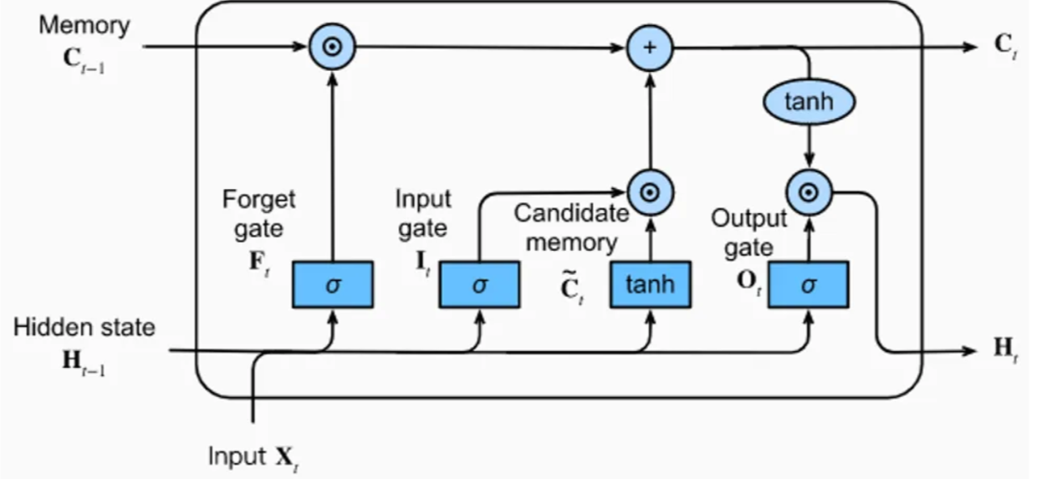
Diagram 1

Slide 6
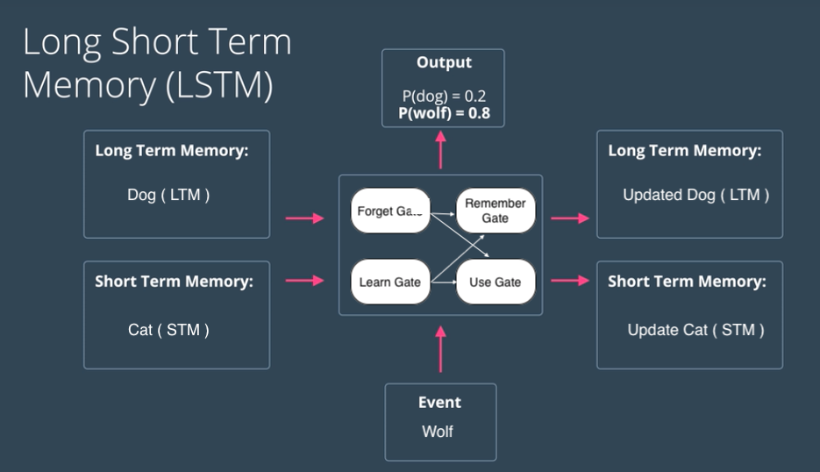
https://www.analyticsvidhya.com/blog/2021/01/understanding-architecture-of-lstm/

Slide 7
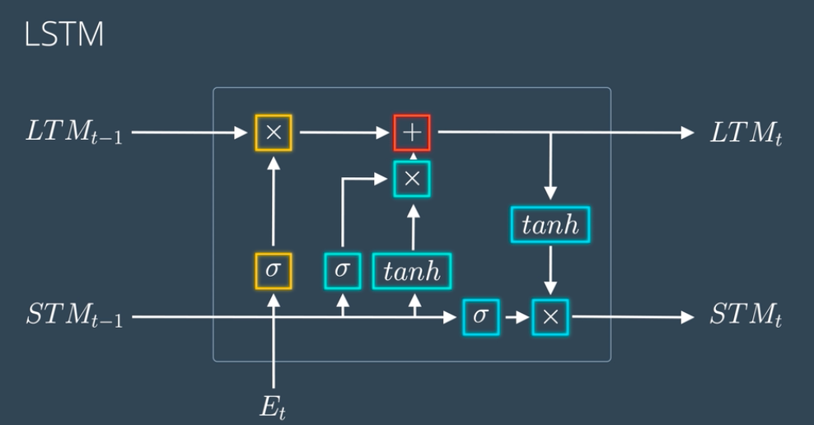

Slide 8
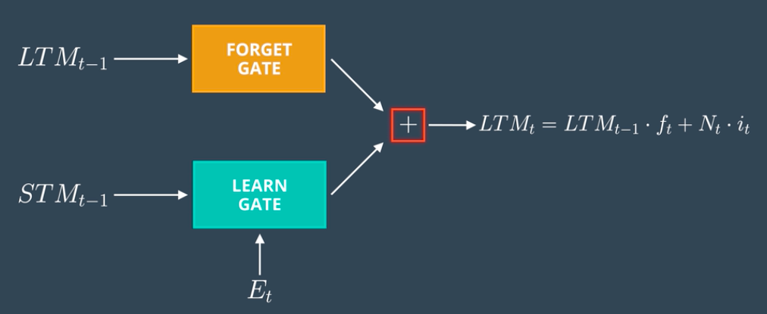
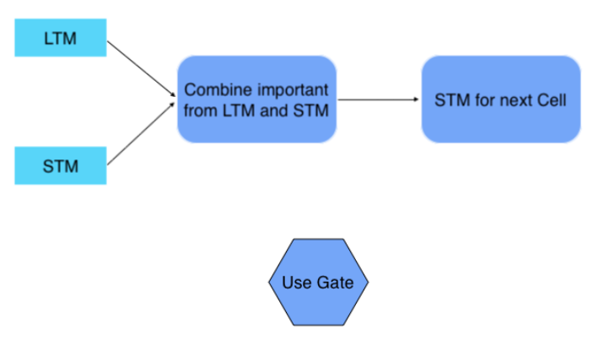
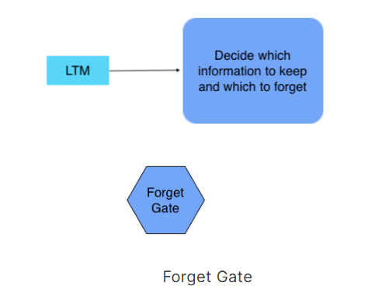
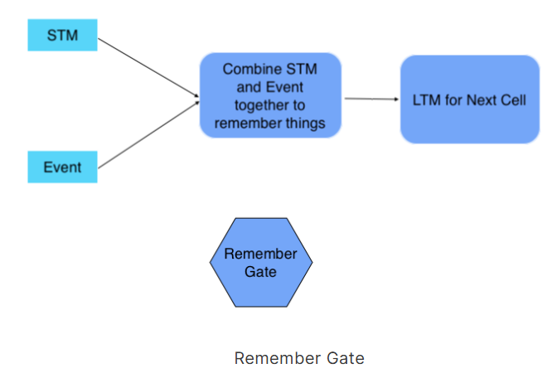

Slide 9

Working of LSTM
Forget Gate:
The forget gate decides what information from the previous cell state C_{t−1} ​ should be discarded. It takes the previous hidden state h_{t−1} and the current input x_{t}​, processes them through a sigmoid layer, and outputs a value between 0 and 1 for each number in the cell state.

Slide 10
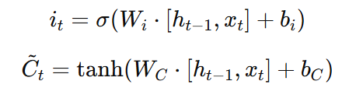
Working of LSTM
Input Gate:
The input gate determines which new information should be added to the cell state. It has two parts:
  First, a sigmoid layer decides which values to update.
  Then, a tanh layer creates new candidate values to potentially add to the cell state.

Slide 11


Working of LSTM
Update Cell State:
The cell state C_{t} is updated by combining the old cell state C_{t-1} (scaled by the forget gate f_{t}​) with the new candidate values​ (scaled by the input gate i_{t}).

Slide 12
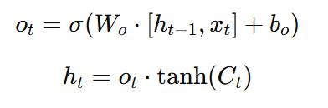
Working of LSTM
Output Gate:
The output gate decides what the next hidden state ℎ_{𝑡} should be, which also serves as the output of the LSTM cell for the current time step.
It is based on the current cell state 𝐶_{𝑡} (passed through a tanh activation) and the output gate value O_{𝑡}.

Slide 13
Advantages
Ability to Capture Long-Term Dependencies:
  LSTMs are designed to address the vanishing gradient problem, which allows them to retain information over extended time steps.
  This makes them highly suitable for tasks that require understanding long-term dependencies in sequences, such as language processing or time-series forecasting.
Efficient Memory Management through Gates:
  The gating mechanisms in LSTMs (input, forget, and output gates) enable the model to selectively update and retain relevant information in the cell state.
  This structure allows LSTMs to learn when to remember and when to forget information, improving the model’s ability to focus on relevant parts of the sequence.

Slide 14
Advantages
Effective for Complex Sequential Data:
  LSTMs can model complex patterns and relationships in sequential data due to their ability to capture hierarchical dependencies.
  This makes them useful for a variety of applications, including natural language processing (NLP), speech recognition, and video analysis.
Handles Variable-Length Sequences:
  LSTMs can process sequences of varying lengths, making them ideal for real-world sequential data that might not have a fixed length.
  For example, in NLP, sentences and paragraphs vary in length, and LSTMs can process them without needing padding or truncation.
Widely Applicable in Many Domains:
  LSTMs have become a go-to architecture for many sequential tasks, ranging from language translation to music generation, sentiment analysis, and anomaly detection.
  Their effectiveness across domains is a testament to their flexibility and reliability.

Slide 15
Disadvantages
High Computational Cost:
  LSTMs are computationally intensive compared to traditional RNNs and simpler architectures.
  Their gating mechanisms require multiple matrix operations per time step, which increases both memory and processing requirements, particularly for long sequences or deep models.
Longer Training Times:
  Training LSTMs can be slow due to the complex computations within each cell and the sequential nature of the data.
  Each time step in the sequence must be processed in order, which limits parallelization and increases training time, especially for large datasets.

Slide 16
Disadvantages
Difficulty with Very Long Sequences:
  While LSTMs are better than traditional RNNs at capturing long-term dependencies, they can still struggle with very long sequences.
  For extremely long dependencies, information can still decay, making it difficult for LSTMs to maintain relevant context over hundreds of time steps.
Sensitivity to Hyperparameters and Initialization:
  LSTMs require careful tuning of hyperparameters such as learning rate, dropout rate, number of layers, and the size of each layer.
  Improper initialization or poorly chosen parameters can lead to slow convergence or poor performance.

Slide 17
Disadvantages
Risk of Overfitting:
  Due to their high model capacity and large number of parameters, LSTMs are prone to overfitting, especially when trained on small or noisy datasets.
  Regularization techniques like dropout or early stopping are often required to mitigate this risk, which can make model training more complex.
Less Efficient on Extremely Long Sequences Compared to Transformers:
  LSTMs process sequences sequentially, which is a disadvantage compared to Transformer architectures that use self-attention to access any part of the sequence directly.
  Transformers tend to perform better on very long sequences (e.g., text generation tasks) and can be trained more efficiently using parallelization.

